Slide 1

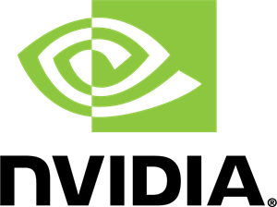


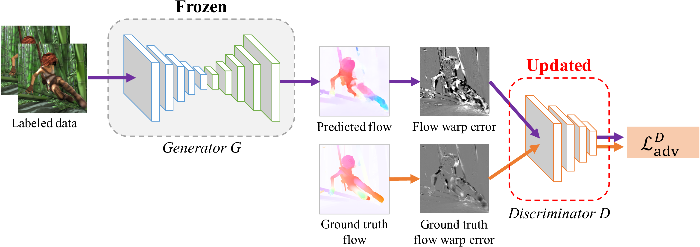
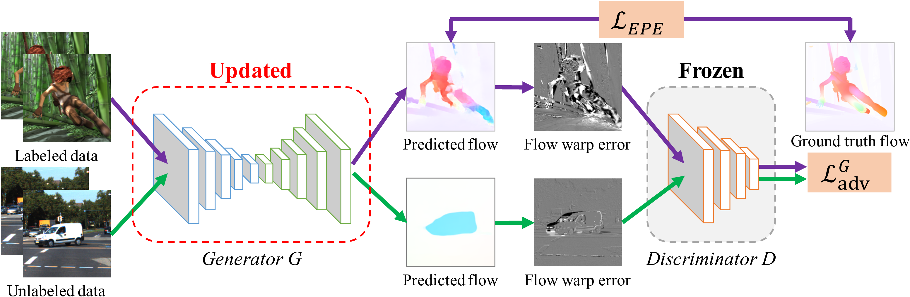
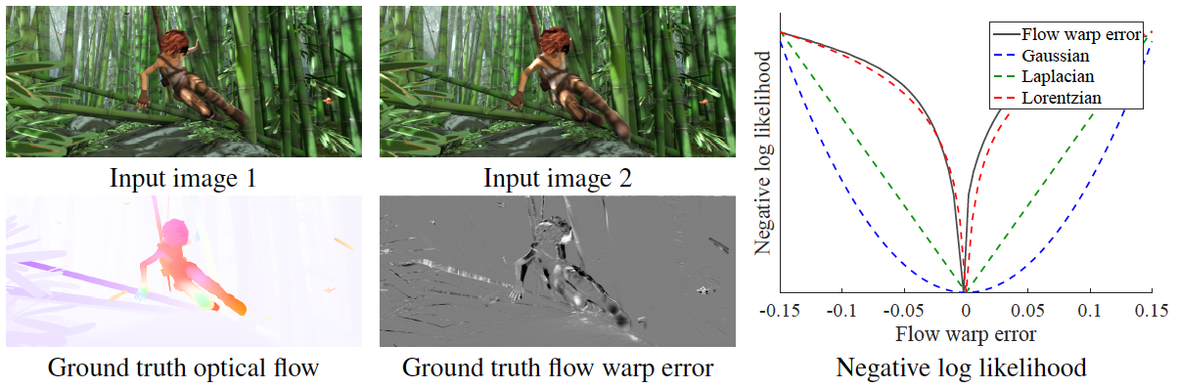
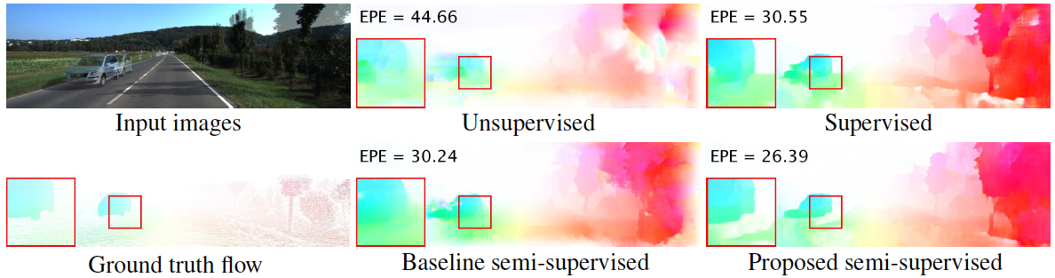
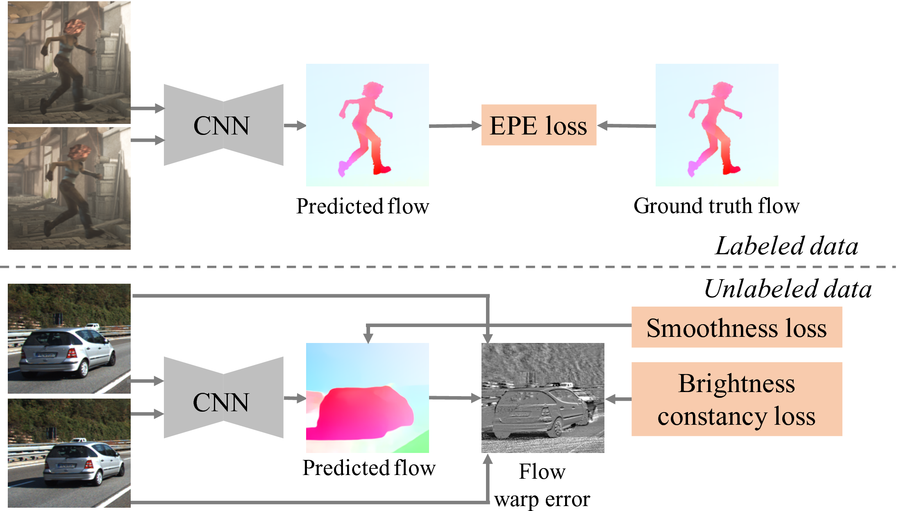
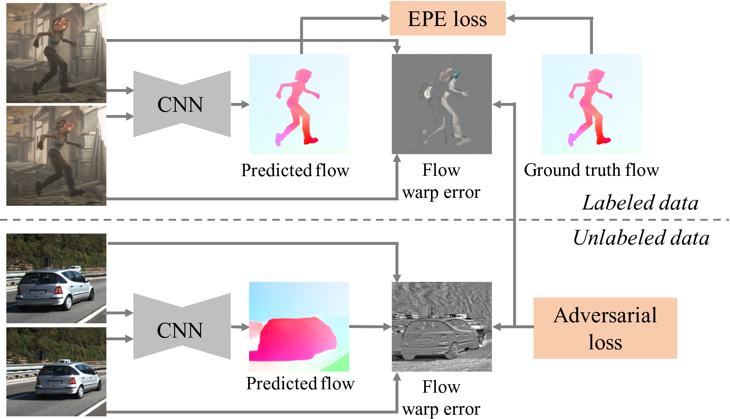
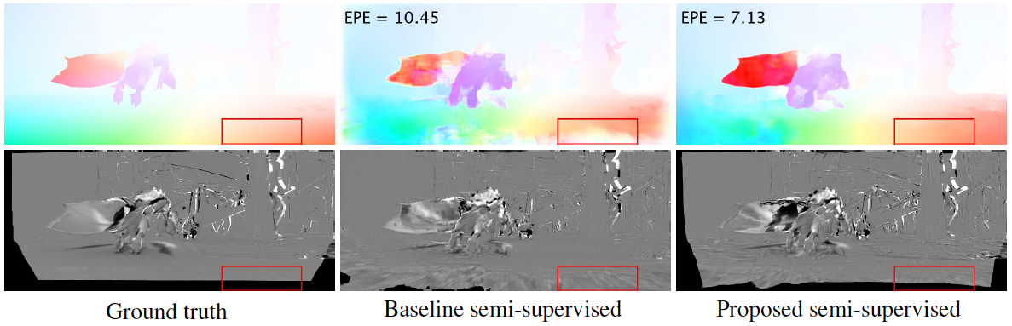
Semi-Supervised Learning for Optical Flow with Generative Adversarial Networks
Wei-Sheng Lai¹, Jia-Bin Huang², Ming-Hsuan Yang^{1,3}
¹University of California, Merced, ²Virginia Tech, ³Nvidia Research
Project website: http://vllab.ucmerced.edu/wlai24/semiFlowGAN/
Contributions
Adversarial Training
Quantitative Evaluation
Semi-supervised learning for optical flow estimation
Training with both labeled (with ground truth flow) and unlabeled (without ground truth flow) data for training
A Generative Adversarial Network (GAN) to capture the spatial structure of flow warp error
Without making assumptions on brightness constancy or spatial smoothness
Update discriminator (D):
Method | Sintel Clean | Sintel Final | KITTI 2012 | KITTI 2015 | FlyingChairs
Supervised | 3.51 | 4.70 | 7.69 | 17.19 | 2.15
Unsupervised | 8.01 | 8.97 | 16.54 | 25.53 | 6.66
Baseline semi-supervised | 3.69 | 4.86 | 10.38 | 18.07 | 2.11
Proposed semi-supervised | 3.30 | 4.68 | 7.16 | 16.02 | 1.95
Motivations
Method | % labeled data | Sintel Clean | Sintel Final | KITTI 2012 | KITTI 2015
Supervised | 75% | 4.35 | 5.40 | 8.33 | 17.43
Proposed | 75% | 3.58 (-18%) | 4.81 (-11%) | 7.30 (-12%) | 16.46 (-6%)
Supervised | 50% | 4.48 | 5.46 | 9.34 | 18.71
Proposed | 50% | 3.67 (-18%) | 4.92 (-10%) | 7.39 (-21%) | 16.64 (-11%)
Supervised | 25% | 4.91 | 5.78 | 10.60 | 19.90
Proposed | 25% | 3.95 (-20%) | 5.00 (-13%) | 7.40 (-30%) | 16.61 (-17%)
Conventional assumptions (e.g., brightness constancy) does not hold on occluded/dis-occluded regions.
Robust loss cannot model the spatial structure of flow warp error.
Update generator (G):
Visual Results
Comparisons with State-of-the-arts
Method | Sintel Clean | Sintel Final | KITTI 2012 | KITTI 2015 | FlyingChairs
FlowNetS | 4.50 | 5.45 | 8.26 | 15.44 | 2.71
FlowNetC | 4.31 | 5.87 | 9.35 | 12.52 | 2.19
FlowNet2 | 2.02 | 3.14 | 4.09 | 10.06 | 1.68
SPyNet | 4.12 | 5.57 | 9.12 | 20.56 | 2.63
Proposed | 3.30 | 4.68 | 7.16 | 16.02 | 1.95
Baseline semi-supervised method
Proposed semi-supervised method

